Slide 1
Team-12 Unitedway Project
By: Malav Patel, Tanzim Ali, David Kim, Leo Hein, Chibueze Anyadike,Bryan Lliguicota

Slide 2
Code for Good
First we will like to thank J.P. Morgan for giving us the opportunity to be creative and give to the community.
In this project, all members compromised on using react for the frontend, and Django Python for the backend server.
We faced a lot of challenges, but the challenges made our teamwork even better. In this presentation, we will discuss how we solve these challenges, and how we implemented our teamwork into making something innovative.

Slide 3
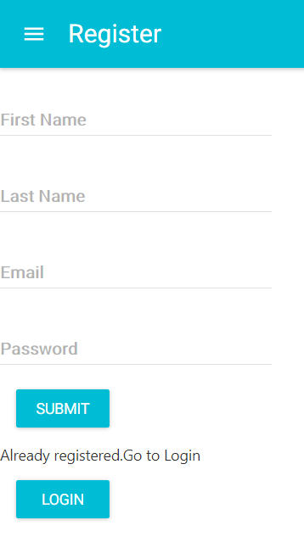

Slide 4
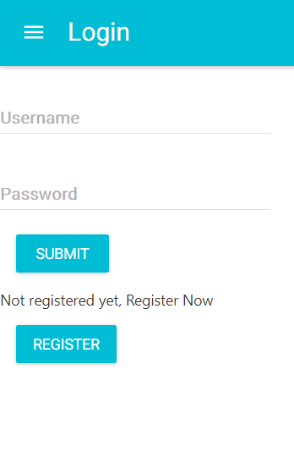

Slide 5
